Slide 1
Design Patterns 2
Reference: Heads First Design Patterns book

Slide 2
DP-1 (Recall)

Slide 3
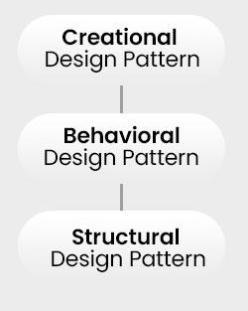
Types of Design Patterns
Creational:
Objects creation mechanisms
Structural:
Objects assemble in large structures
Behavioral:
Objects communication effectively
Notes:
Don’t explain any of them in details..

Slide 4
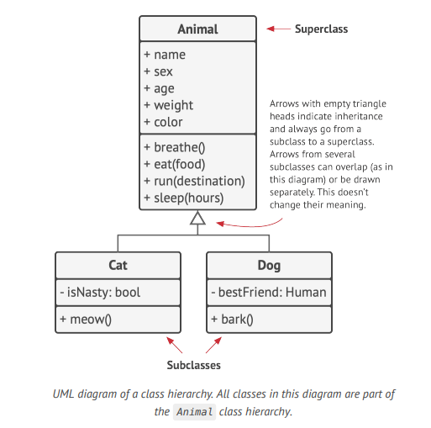
Class hierarchies
Superclass (interface class)
Subclasses (concrete class)

Slide 5
Design Principles (Cont.)
4. Don’t Repeat Yourself (DRY)
Emphasizes reducing code duplication. Encourage developers to avoid writing the same code in multiple places and instead abstracting repeated logic into functions, modules, or classes.

Slide 6
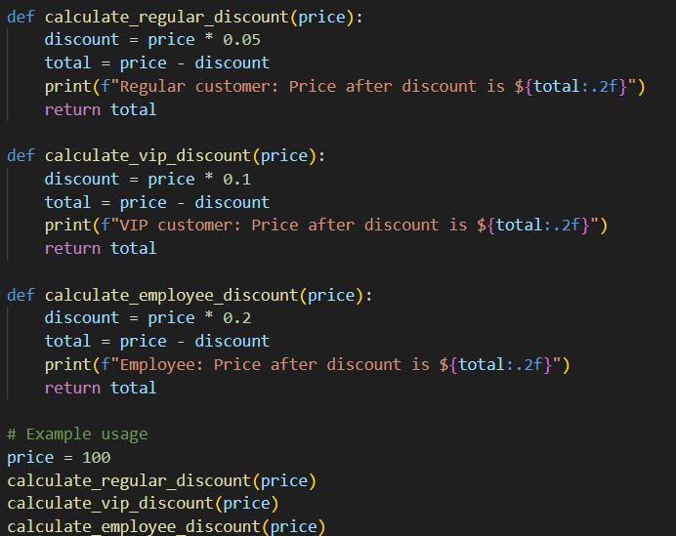
Notes:
What’s the problem here?? Each function calculates a discount but duplicates similar code for printing, calculating, and returning the total. If any logic in the discount calculation or output formatting changes, we need to update each function individually, increasing maintenance effort and the chance of errors.

Slide 7
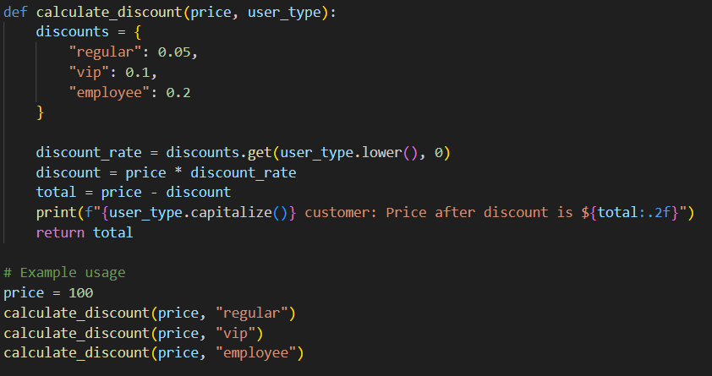

Slide 8
Chocolate Factory Problem

Slide 9
Problem Description
Imagine a chocolate factory where a boiler is used to melt chocolate and milk. The factory’s system has a boiler class that controls when the boiler is filled, emptied, and boiled. The problem is that there can only be one boiler filled with chocolate and milk at any time, and once filled, it shouldn't be filled again until it’s empty. However, the current implementation doesn’t prevent multiple instances, and if the system accidentally creates two boiler instances, they could both end up filled, causing production errors.

Slide 10
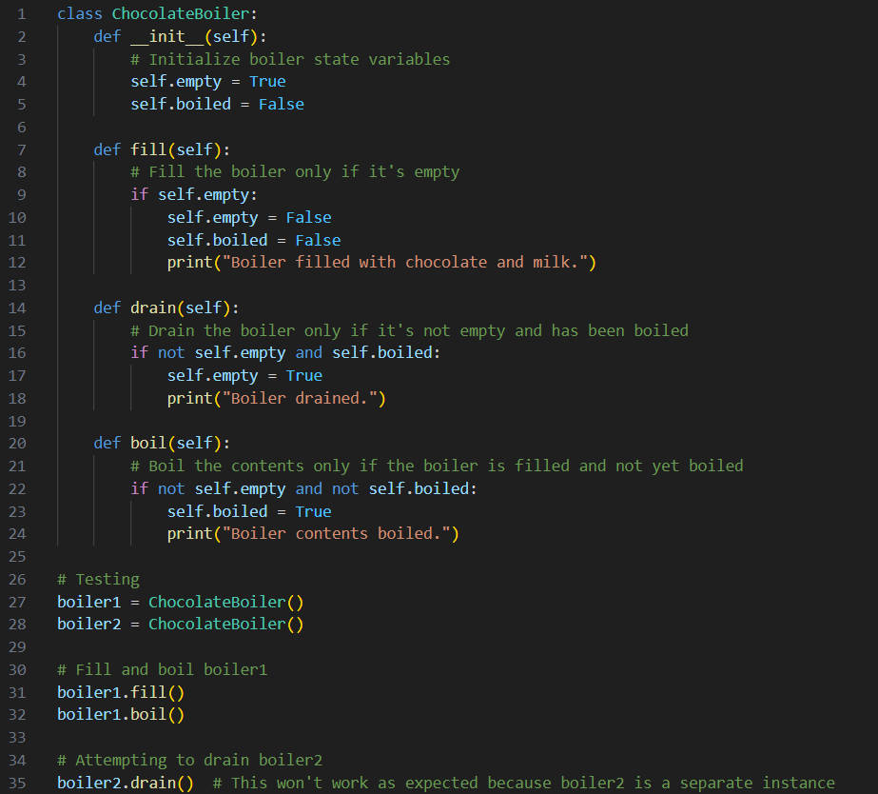
Notes:
The code of the problem. What can we do to make sure that there is only one boiler??

Slide 11
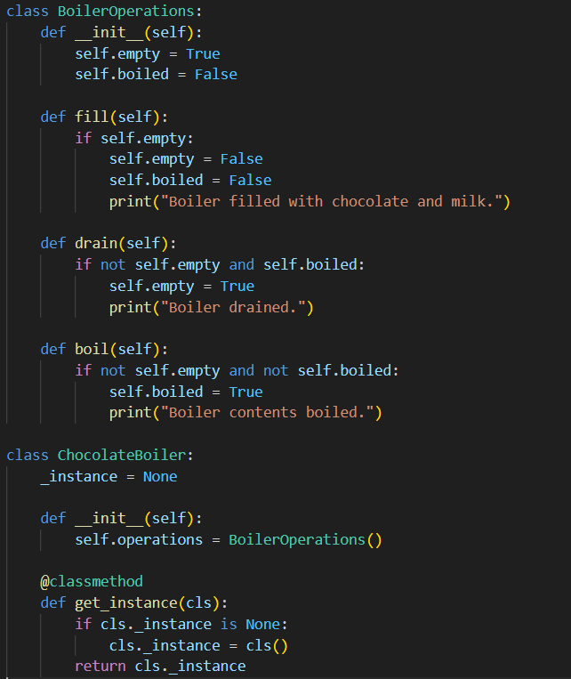
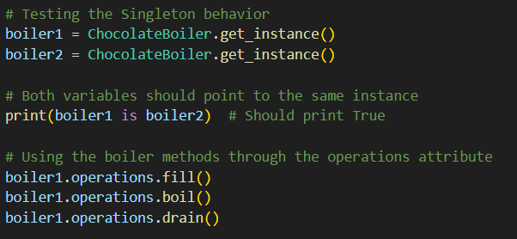
Notes:
The code of the solution:
The @classmethod decorator tells Python that get_instance is a class method rather than a regular instance method. This will allow get_instance to be called from the class itself. This is not available in all language, so, the Singleton design pattern is implemented differently for each language, but the premise remains the same.
In C++, we use a static instance pointer within the class itself and a private constructor to prevent multiple instances. In JavaScript, we check within the constructor if an instance exists (using ChocolateBoiler.instance) and return that instance if it does.

Slide 12
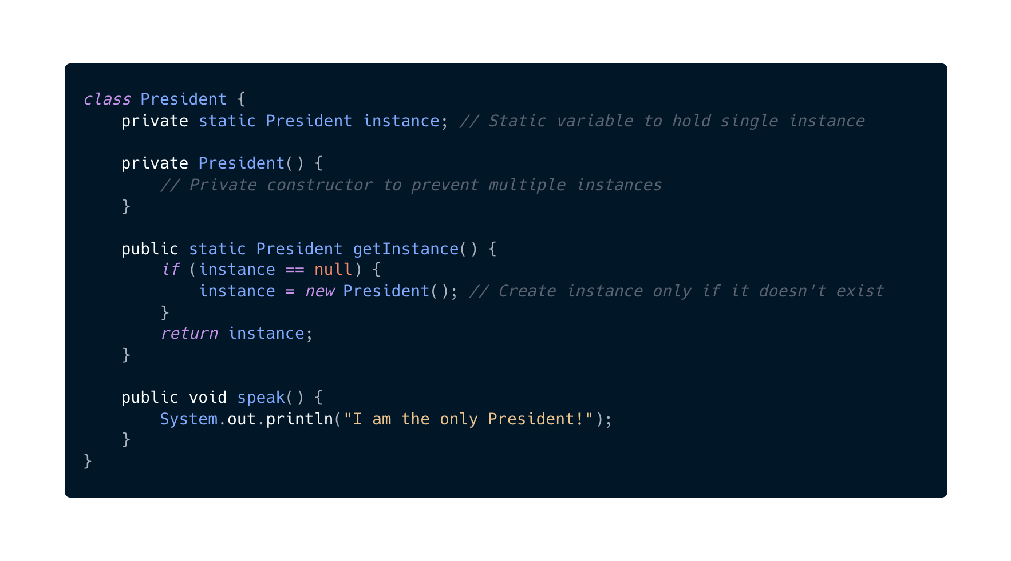
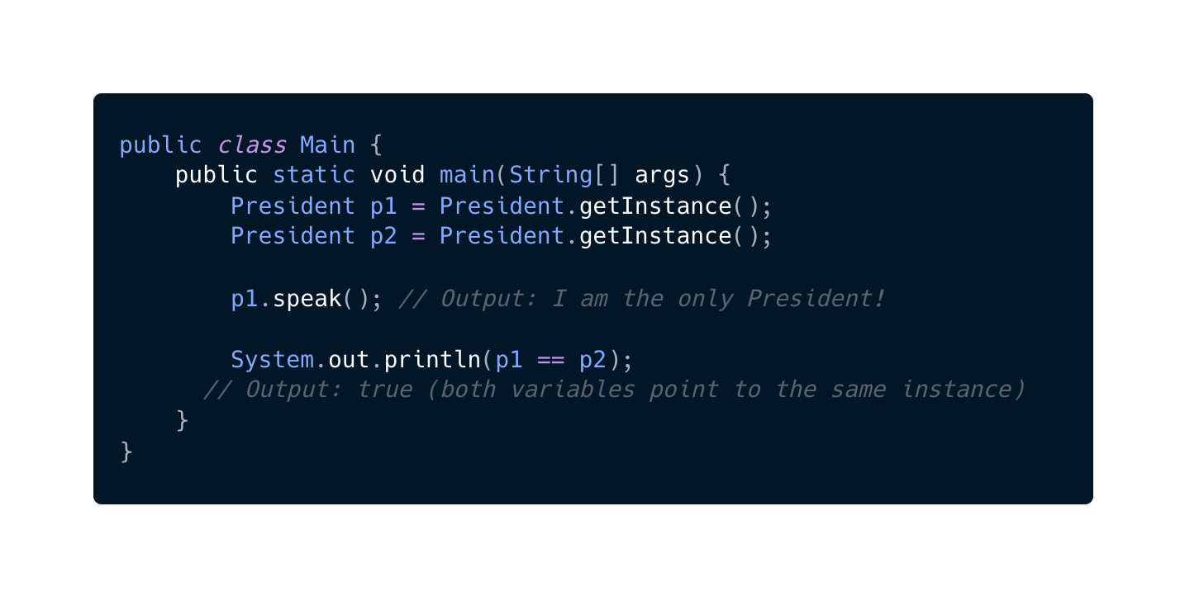

Slide 13
Singleton
A class with only one instance.
This instance is used across the whole project.
It can be used in so many use cases:
Logging
DB
Global variables vs Singleton
Globals are always instantiated even if we did not use them (wasting resources) while singleton is instantiated only when we use them in the code.
Singleton makes sure that no developer can instantiate more than one instance while global variables can be modified.
Global variables can’t handle inheritance.
Singleton is a Creational Design pattern

Slide 14
Design Principles Followed By Singleton
Encapsulate What Varies
The Singleton pattern encapsulates the process of instantiation, making it part of the class itself.
This encapsulation ensures that users of the class don’t have to worry about how many instances there are or how they’re managed.
S in SOLID:
The Singleton class has a single responsibility — to manage its unique instance.
Notes:
Recall:
S stands for single responsibility principle

Slide 15
Starbuzz Coffee Problem

Slide 16
Problem Description
Imagine you’re building a system for a coffee shop. The coffee shop offers different types of coffee (e.g., Espresso, House Blend) with a variety of add-ons like milk, soy, mocha, and whipped cream. Each add-on has an additional cost.

Slide 17
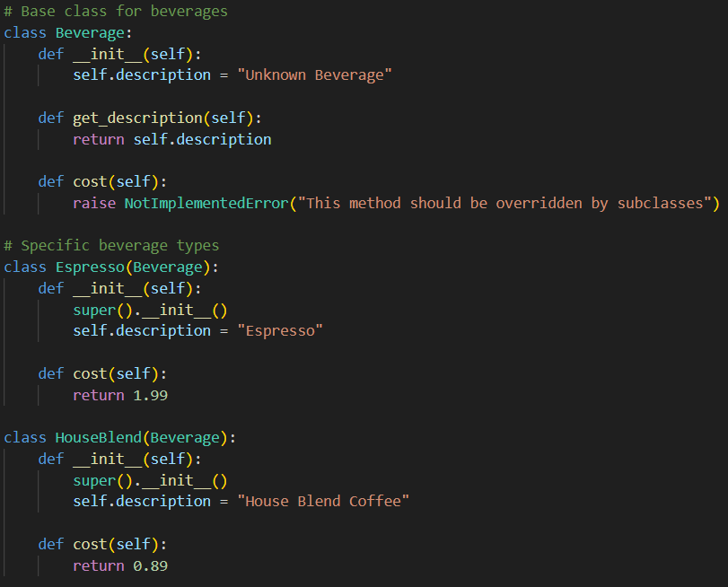
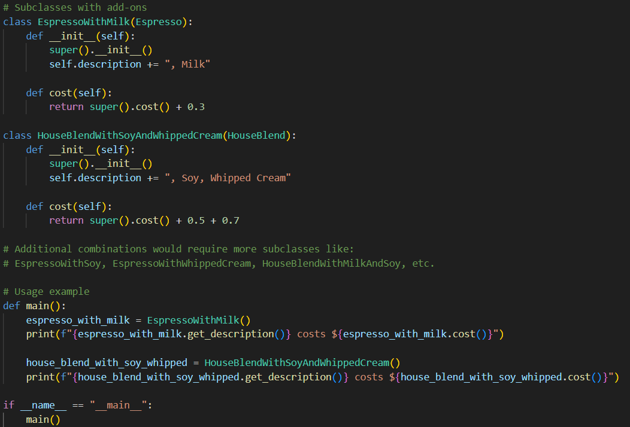
Notes:
One such solution (bad). We have a lot of combinations!

Slide 18
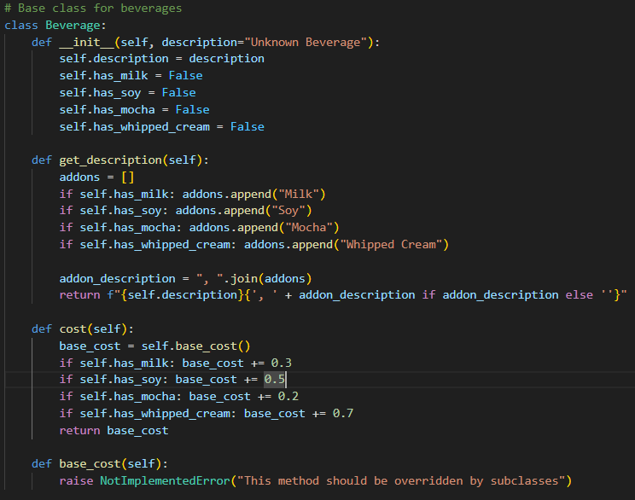
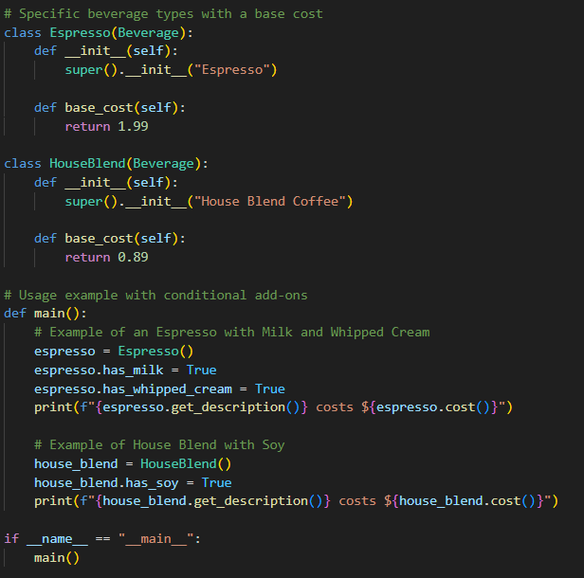
Notes:
Another solution (also bad). What if we want to change the prices of add-ons or add different add-ons?

Slide 19
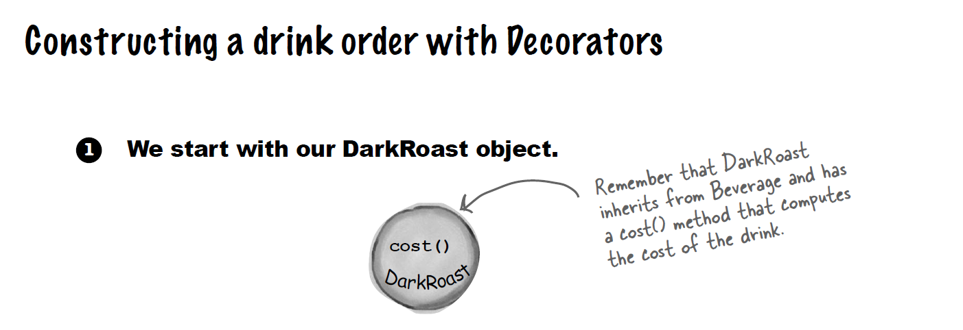
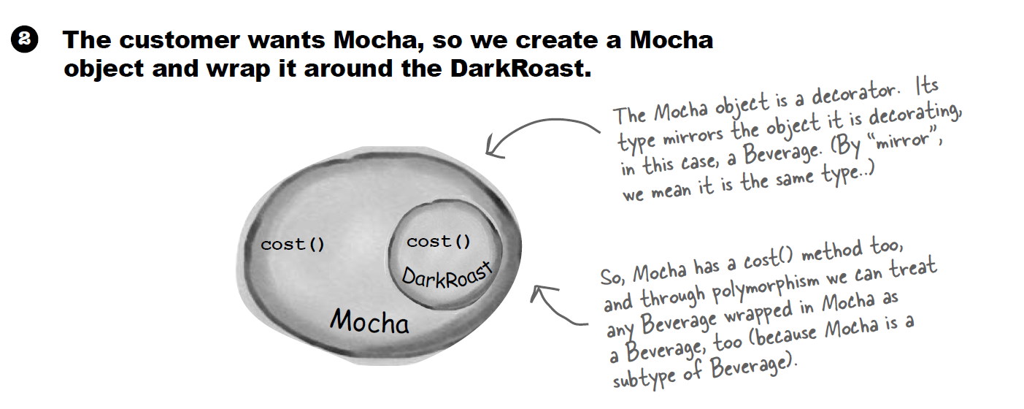

Slide 20
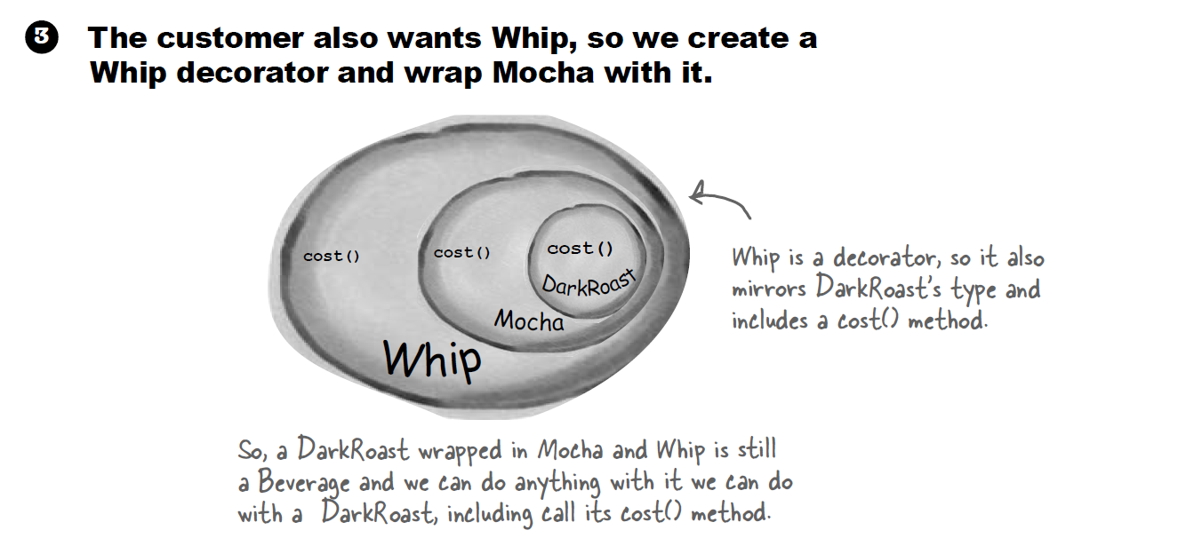

Slide 21
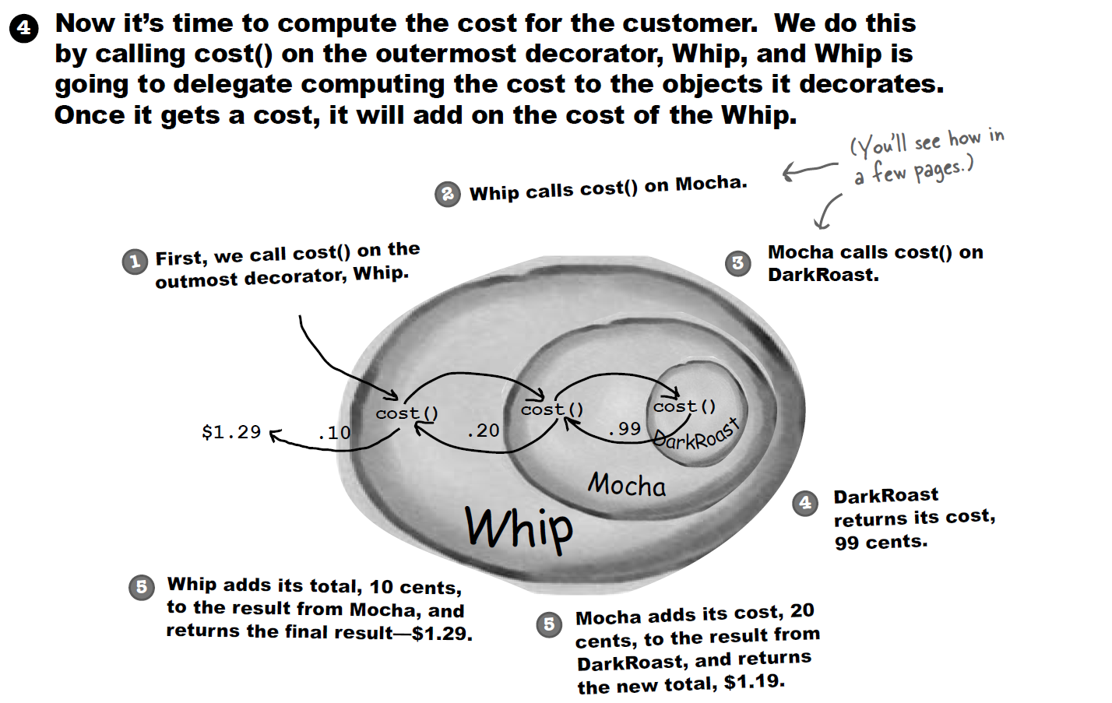

Slide 22
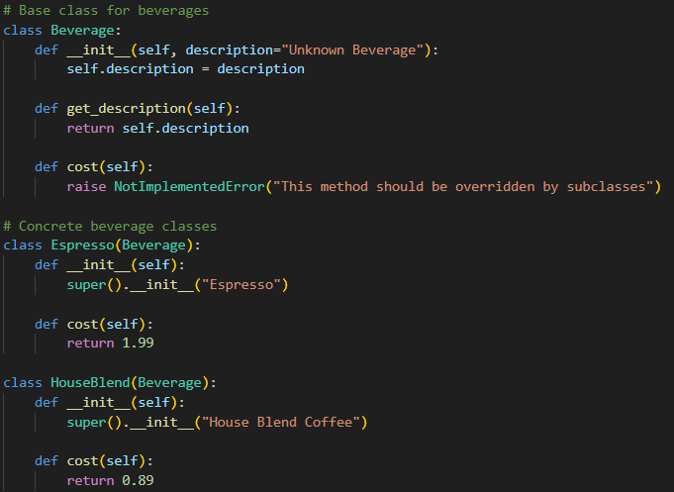
Notes:
The code of the solution

Slide 23
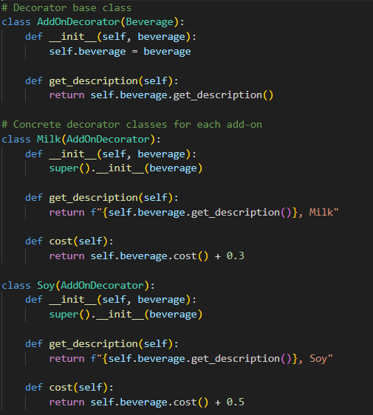
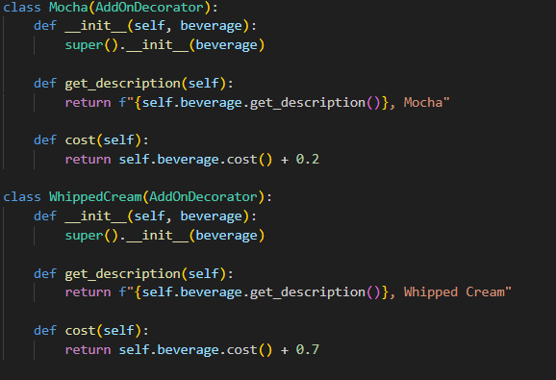
Notes:
The code of the solution

Slide 24
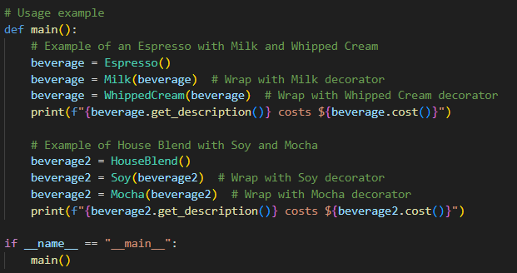
Notes:
The code of the solution

Slide 25
Decorator
Behavior is added to individual objects, dynamically, without affecting the behavior of other objects from the same class.
It can be used in so many use cases:
Coffee shop orders
UI Components (adding visual elements to base UI component)
Combination Classes vs Conditions vs Decorator
Instead of creating multiple subclasses for each combination, the decorator pattern allows combining features at runtime
Rather than adding flags or conditions within a single class, each decorator handles a specific feature, maintaining separation of concerns
Decorator is a Structural Design pattern

Slide 26
Design Principles Followed By Decorator
Encapsulate What Varies
Each decorator encapsulates a specific additional behavior or feature (e.g., milk, soy, mocha in the coffee example) separately from the main object.
Favor Composition Over Inheritance:
Instead of creating subclasses for each combination, each decorator class is composed with the base object (the Beverage) and wraps it to add new functionality. This makes it easier to create flexible, dynamic combinations at runtime.
S in SOLID:
Each decorator class has a single responsibility (e.g., adding milk or soy), keeping the classes small and focused on one task.
O in SOLID:
The base Beverage class remains closed for modification (no need to change it for new add-ons) but open for extension through new decorators.
Notes:
Recall:
S stands for single responsibility principle
O stands for open/closed principle

Slide 27
Weather Station Problem

Slide 28
Problem Description
Imagine you’re building a Weather Station application that monitors and displays real-time weather data (like temperature, humidity, and pressure). Initially, you only have one display screen showing this data, so it’s manageable.
Now, the requirements have changed:
You need multiple displays, each showing different views, like a Current Conditions Display, a Statistics Display, and a Forecast Display.
Each display needs to update immediately when the weather changes.
The system must be scalable, allowing new types of displays to be added later.

Slide 29
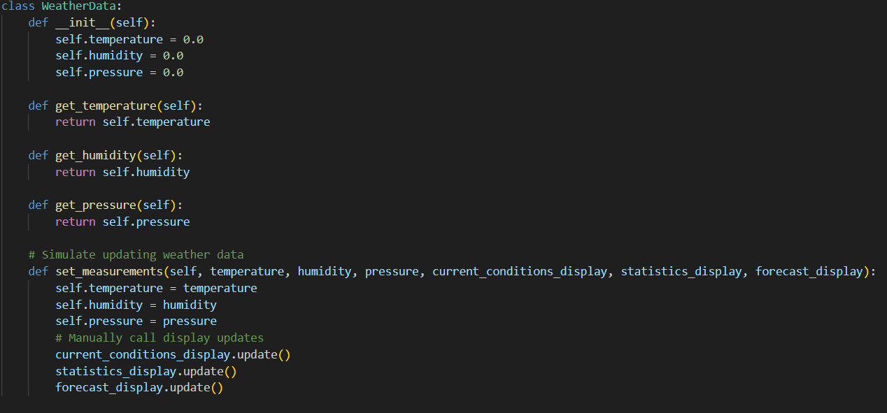
Notes:
One such solution (bad). This solution introduces tight coupling, where each display class is directly tied to WeatherData. Adding or removing displays requires modifying WeatherData.

Slide 30
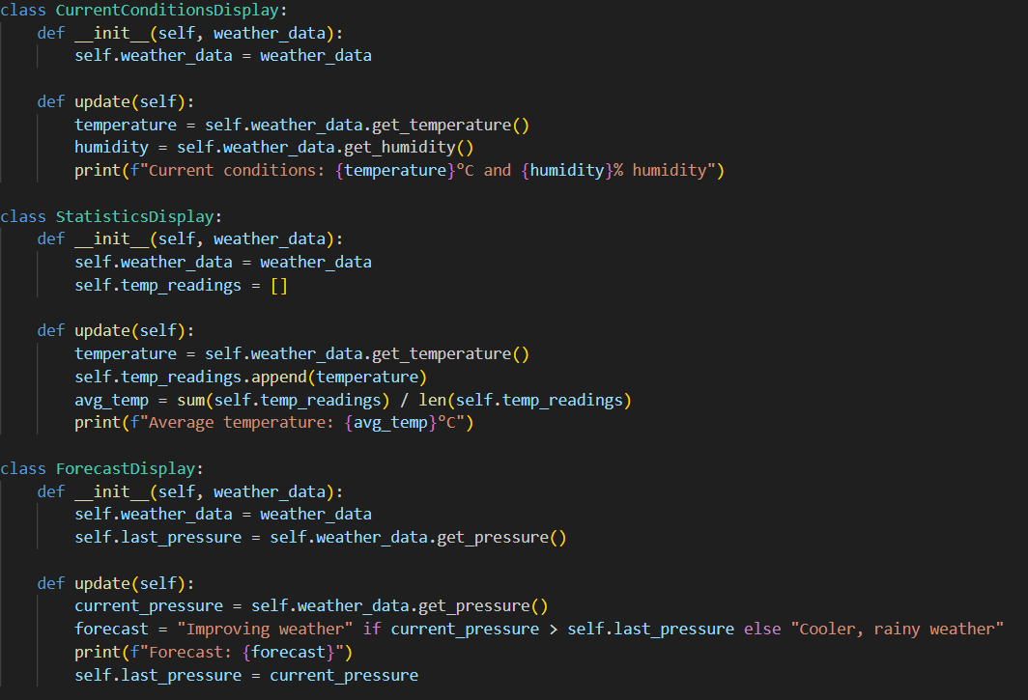

Slide 31
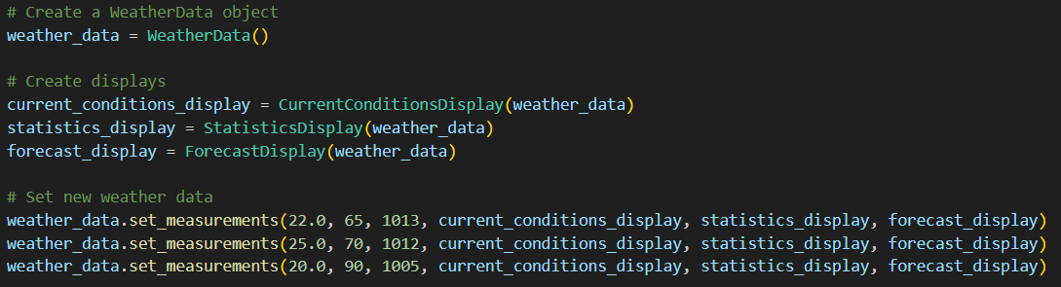

Slide 32
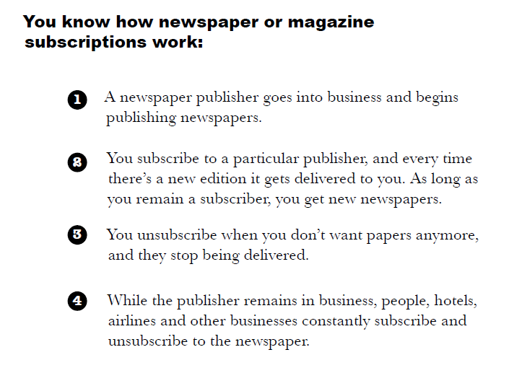

Slide 33
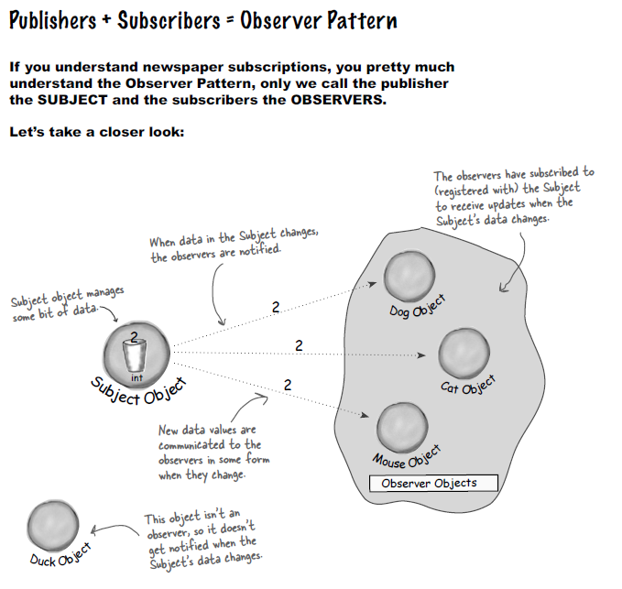

Slide 34
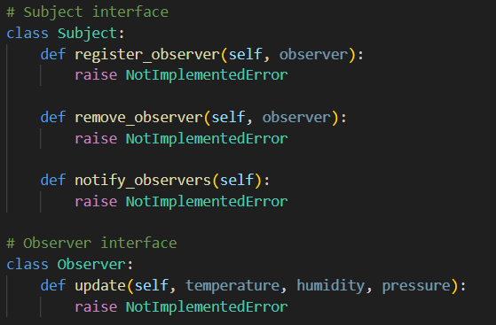
Notes:
The code of the solution

Slide 35
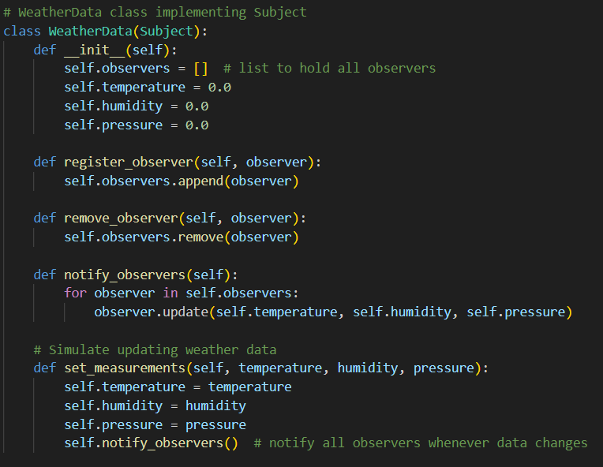
Notes:
The code of the solution

Slide 36
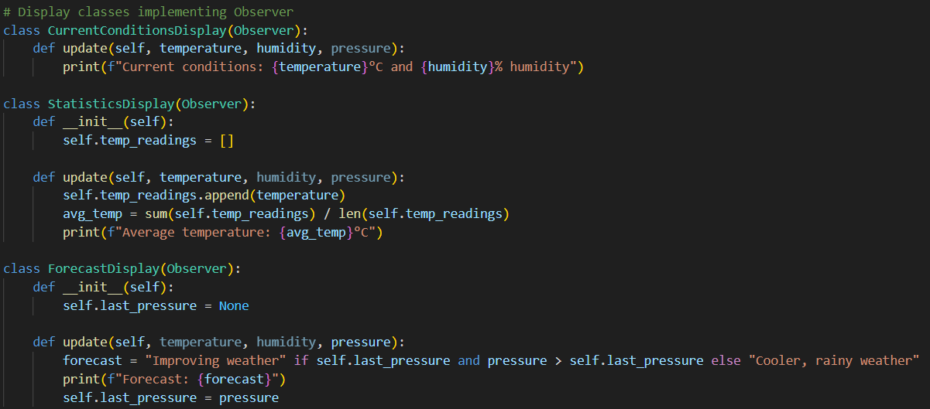
Notes:
The code of the solution

Slide 37
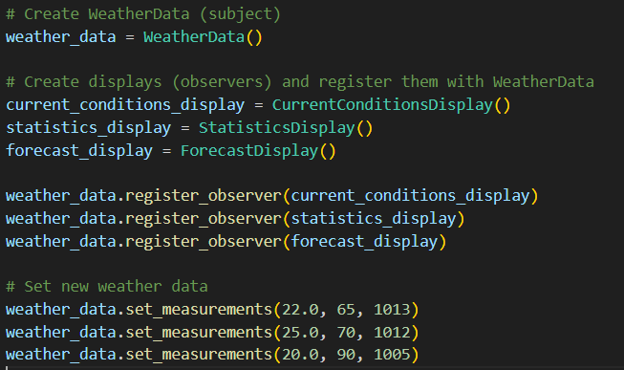
Notes:
The code of the solution

Slide 38
Observer
An object (subject) maintains a list of dependent objects (observers) and notifies them of any changes, usually by calling one of their methods.
It can be used in so many use cases:
Applications like weather stations or stock tickers where data changes frequently
Alerts, or push notifications where users need updates without polling for data
Direct Approach vs Observer
Direct approach leads to tight coupling, any addition/removal in one of the classes that need to be modified will cause changes to the class supplying the data.
Observers and the subject don’t need to know each other’s details. You can add/remove observers without modifying the subject.
Decorator is a Behavioral Design pattern

Slide 39
Design Principles Followed By Observer
Encapsulate What Varies
The Observer pattern encapsulates the changing set of observers. The WeatherData subject doesn't need to know how many observers there are or how they operate. It simply notifies all observers when data changes, allowing for flexibility in adding, removing, or changing observers without modifying the WeatherData itself.
Program to an Interface, Not an Implementation:
Observers interact with the WeatherData through a common interface (Observer), not through concrete classes. This allows any new display (observer) class to be added as long as it implements the Observer interface, without modifying the WeatherData class.
O in SOLID:
WeatherData is open for extension (adding new observers) but closed for modification (no need to change its code to accommodate new observers).
D in SOLID:
WeatherData (high-level class) depends on Observer (abstract class) rather than concrete classes, which reduces dependencies and supports extensibility.
Notes:
Recall:
O stands for open/closed principle
D stands for dependency inversion principle

Slide 40
Thank You

